Slide 1
Outage Management & Restoration Software
Monitoring & Managing Service Interruptions

Slide 2
Introduction
Outages are unexpected disruptions in services such as electricity, internet, or network systems that can significantly impact daily activities and operations. Traditional manual reporting methods often lead to delays, miscommunication, and inefficiencies in resolving these issues.
Therefore, there is a need for a centralized system that can effectively monitor outages, notify users in real time, and track the resolution status.
This project aims to address these challenges by providing a real-time outage tracking platform that enhances communication, improves response time, and ensures better management of service disruptions.

Slide 3
Problem Statement
Lack of real-time outage information
Poor communication between users and service providers
Delay in outage resolution tracking
No centralized reporting system
Users remain unaware of service restoration time
Limited tracking capability
Time-consuming process

Slide 4
Objectives
Develop a system to report and monitor outages
Provide real-time updates
Enable user notifications
Improve response time
Maintain outage history and analytics

Slide 5
System Architecture
Frontend: React + Tailwind + Framer Motion
Backend: Node.js + Express
Database: MongoDB
Authentication: JWT
Flow:
User → Frontend → Backend → Database

Slide 6
User Roles
Customer
Report outages
Track status
Technician
View assigned tasks
Update status
Admin
Manage users
Assign outages
Monitor system

Slide 7
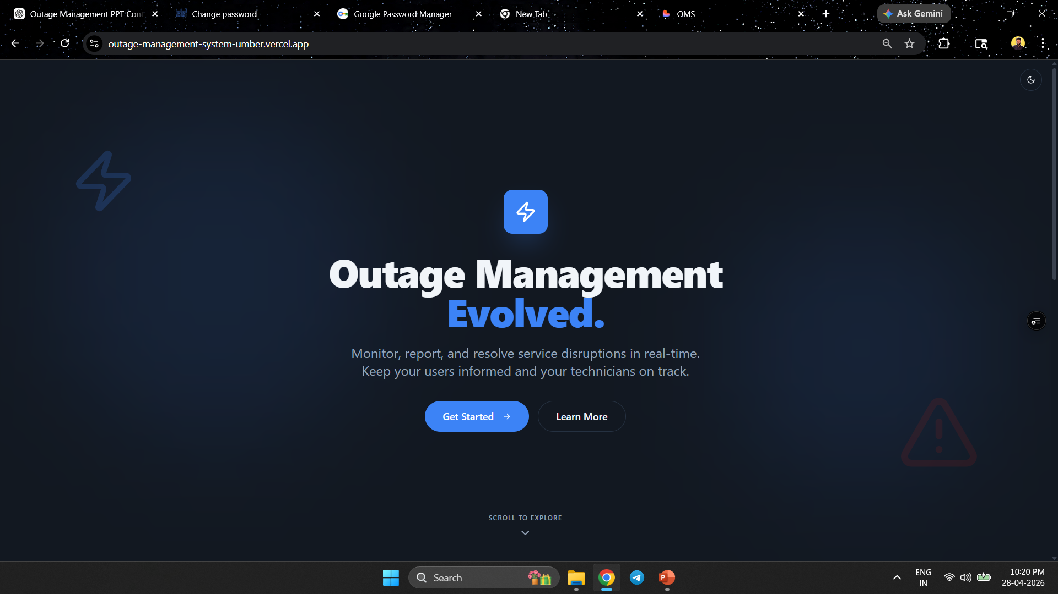

Slide 8
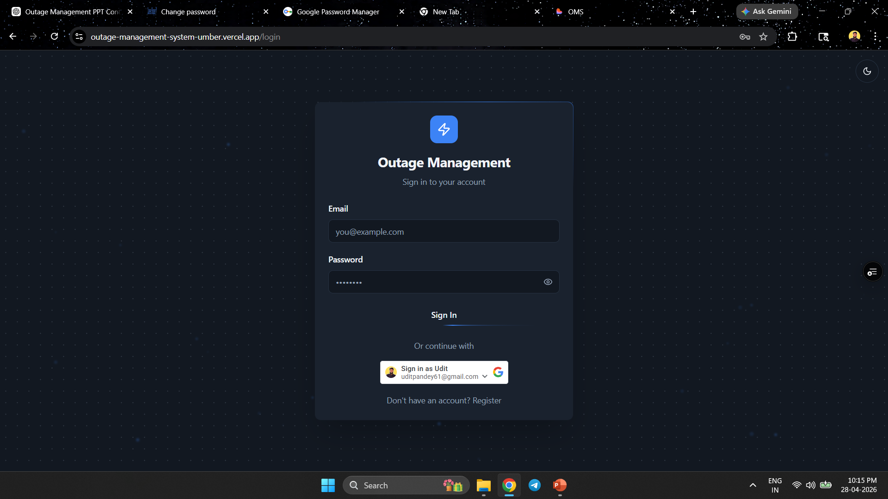
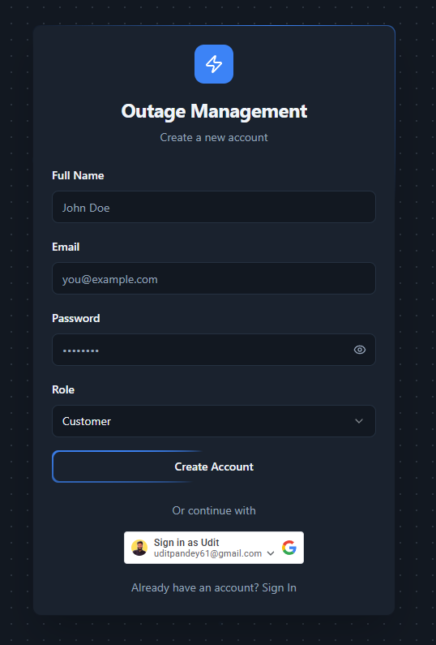
Text Slide- Heading, Metropolis Semi bold-36

Slide 9
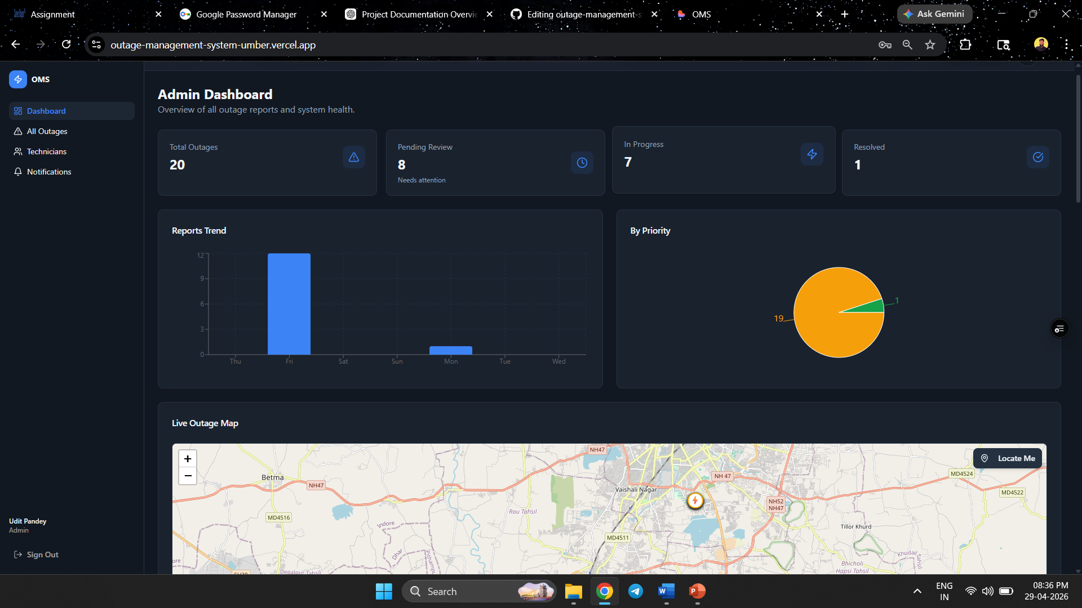

Slide 10
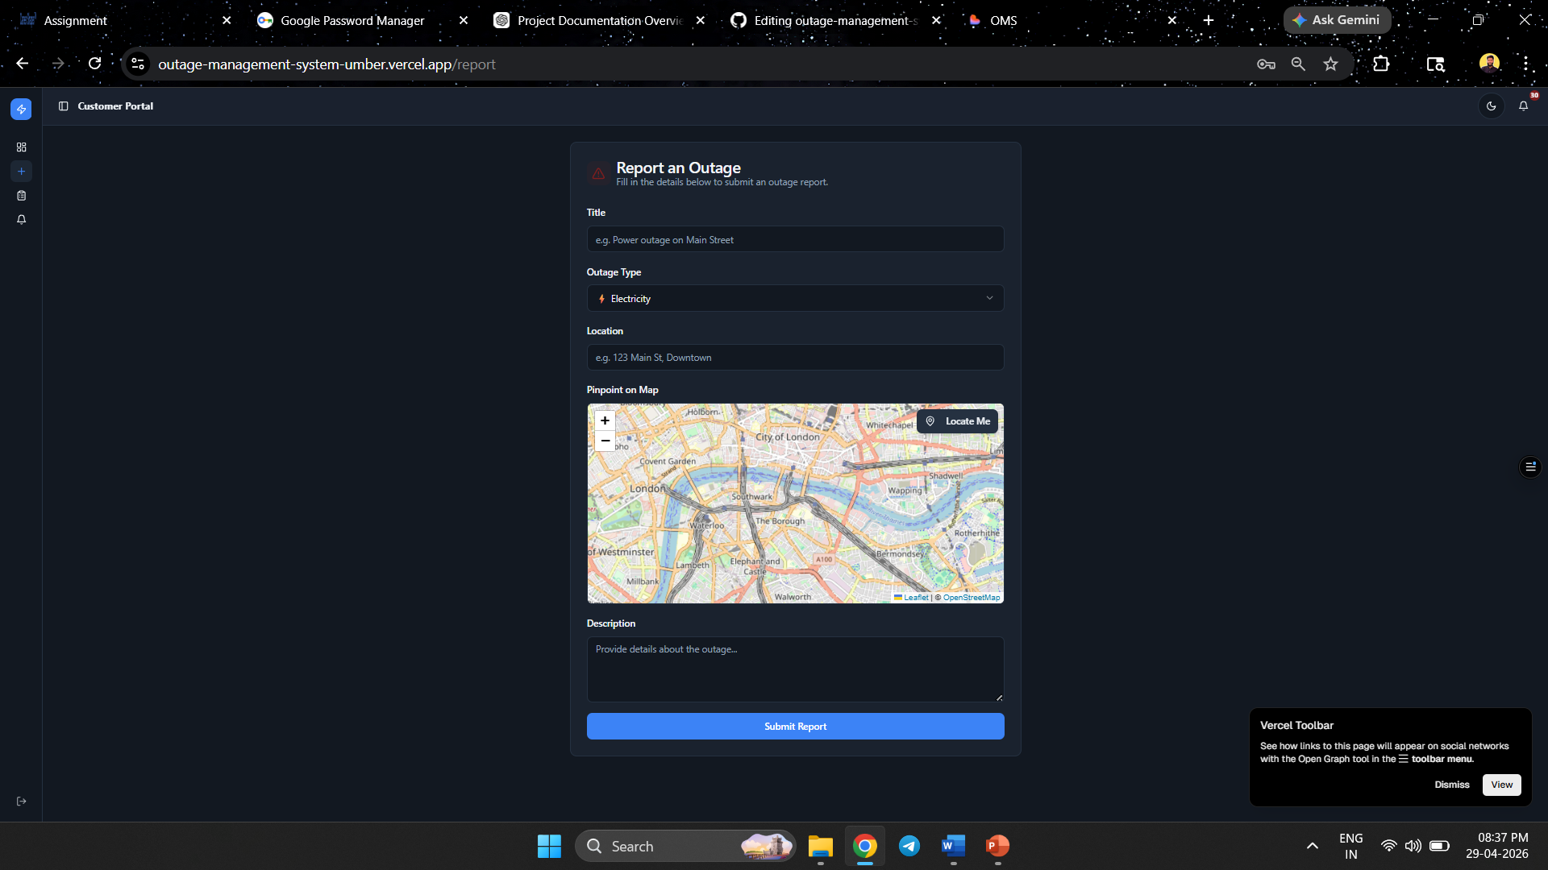
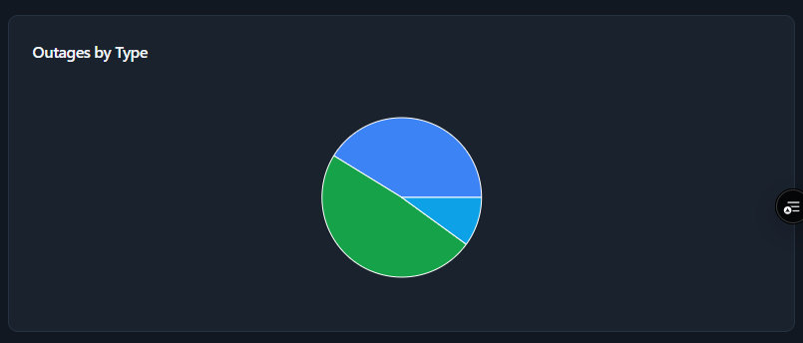

Slide 11
Advantages
Faster issue resolution
Transparency
Centralized system
Better communication
Easy tracking

Slide 12
Thank You!

